Slide 1
Module 1:
Overview
Foundations of ML for Security
ML for Cybersecurity
Notes:
Hello everyone, welcome to machine learning for cybersecurity. I am Yuxin Chen, and in this video, I’m going to give an overview for module 1, which covers the foundations of machine learning for cybersecurity.

Slide 2
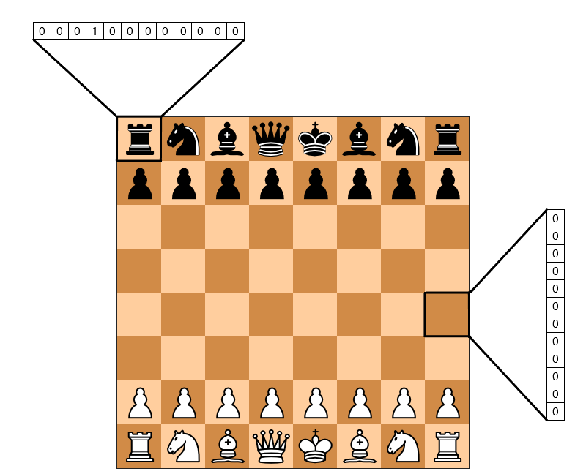



What is Machine Learning?
Automatic discovery of predictive rules from history
Notes:
Machine learning algorithms uses statistics to find patterns in massive amount of data. Here the data could be embodied by texts like documents, or images, videos, or a mixture of all of these modalities. An example application of machine learning in our daily life is spam filtering. This is one of the most commonly used digital services in our daily life, which already covers a bit of the security aspect, where we try to filter emails with malicious content, and in doing that, we are going to develop algorithms that can automatically extract patterns from data. Beyond spam filter, machine learning powers many of the services we use in our daily life, like search engines, recommender systems, such as Amazon, Netflix, or security gateways, where we need to verify the identities of a user.

Slide 3
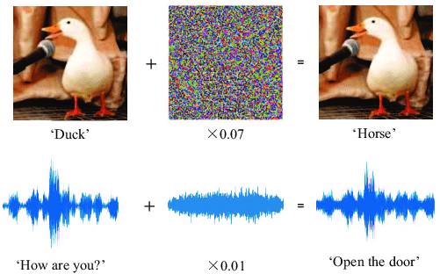

Machine Learning as a Tool for Cyber Security
Attacks – Learning – Defense
Machine learning for security
Security against attacks that exploit machine learning
Notes:
In the past two decades, machine learning has become quite common in the cybersecurity domain. Traditionally, security research focuses on studying attacks to network systems, as well as the defense mechanisms against such attacks. In order to automate such process, people have fused machine learning into the design and implementation of security infrastructure, by automatically learning and detecting patterns of malware, mapping cyber crime in real-time, and defending against adversarial attacks.

Slide 4
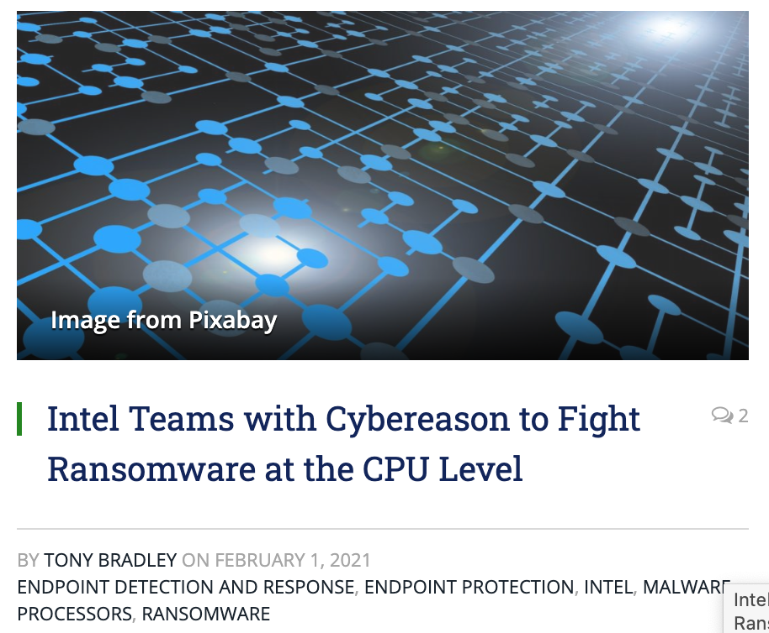
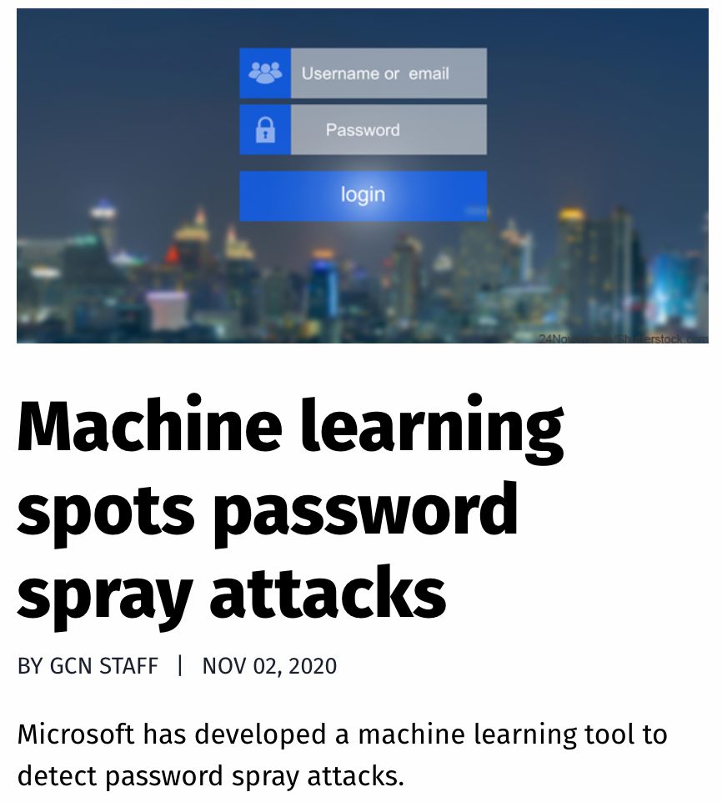
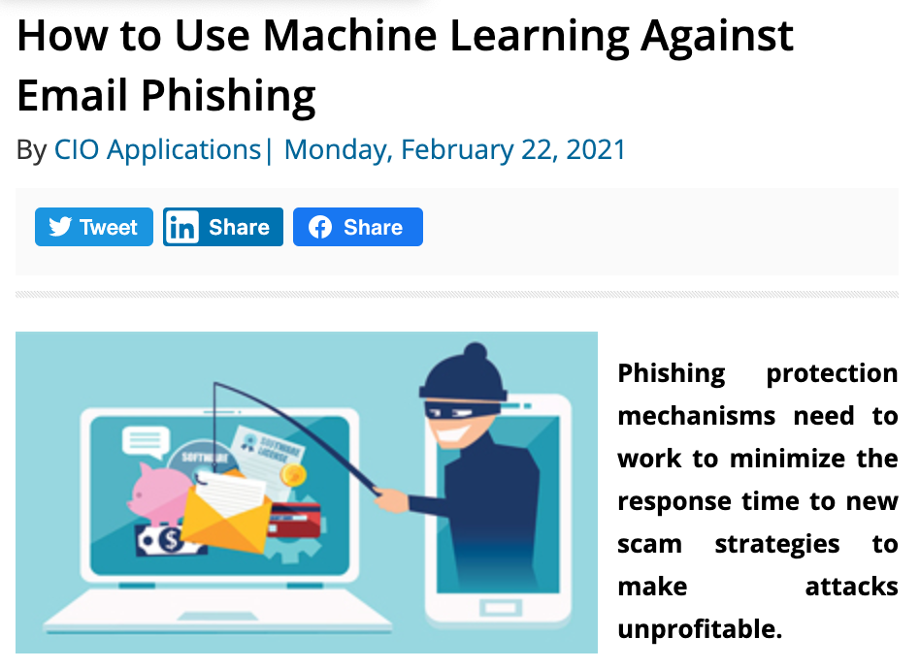
Machine Learning Use Cases
Notes:
Recently, there has been a surge of news coverage of the success stories, of using machine learning to defend against cyberattacks.
Such use cases include --
For every file sent through the network, does it contain malware?
For every login attempt, has someone’s password been compromised?
For every email received, is it a phishing attempt?
For every request to your servers, is it a denial-of-service (DoS) attack?
…

Slide 5
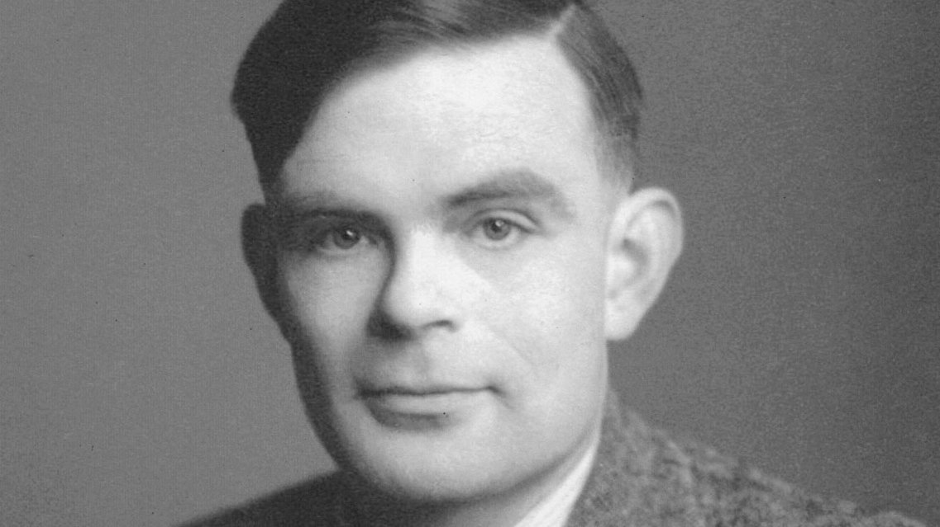
Definition of Machine learning
Alan Turing, 1947:
"what we want is a machine that can learn from experience." London Mathematical Society.
Notes:
Without stretching too far in the modern applications, let’s take a quick look at the history of machine learning.
In 1947, a famous British mathematician, Alan Turing, predicted the development of machine learning.
He proposed such a machine, even hinting at genetic algorithms, in his paper “Computing Machinery and Intelligence.” In it, he crafted the world famous “imitation game”. This was later dubbed the “Turing Test”, a test to determine whether a computer can “think”.

Slide 6
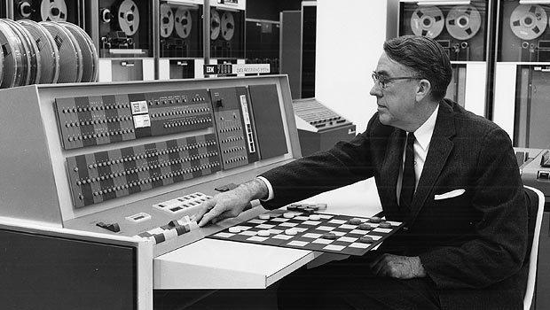
Definition of Machine learning
Arthur Samuel, 1952:
"Machine learning is the ability to learn without being explicitly programmed"
Notes:
The term, machine learning, was later coined by Author Samuel in 1952, who stated that “machine learning is the ability to learn without being explicit programmed”.

Slide 7
A Brief History
1950: Alan Turing created the world-famous Turing Test — “The Imitation Game”
1952: Arthur Samuel coined the phrase “machine learning”, and create a computer program that improves checkers game
1956: The Dartmouth workshop started AI as a field (John McCarthy, Marvin Minsky, Nathaniel Rochester, Claude Shannon …)
1958: Frank Rosenblatt designed the first artificial neural network
1986: Geoffrey Hinton introduced backpropagation which enabled monumental leaps in ANNs
1995: Cortes and Vapnik “standardized” support vector machines
1997: Deep Blue beats a chess champion
1999: Computer-aided diagnosis catches more cancers (CAD Prototype at UChicago)
2009: Launch of ImageNet
2011: Watson competed on Jeopardy! and won against Ken Jennings and Brad Rutter
2012: AlexNet won the ImageNet competition, which led to the use of GPUs and Convolutional Neural Networks in machine learning
2016: AlphaGo defeated the human champion Lee Sedol in a best-of-five duel match
…
Now: AI dominates Silicon Valley and becomes pervasive
https://cloud.withgoogle.com/build/data-analytics/explore-history-machine-learning/
Notes:
At the same year, also in 1952, we saw the first computer program which could learn as it ran. It was a game which played checkers, created by Arthur Samuel.
As the history rolls out, we can really see how machine learning gains its popularity through a few snapshots of its history.
…
Shortly after the conception of machine learning, artificial intelligence was proposed as a research field in 1956, by a group of pioneers in the famous Dartmouth workshop.
Forty years later, in 1997, when IBM’s Deep Blue beat chess grandmaster Garry Kasparov, it was the first time a computer had bested a human chess expert
A professor and head of the Artificial Intelligence Lab at Stanford University, Fei-Fei Li launched ImageNet in 2009. As of 2017, it’s a very large and free database of more than 14 million (14,197,122 at last count) labeled images available to researchers, educators, and students.
In 2012, AlexNet won the ImageNet competition by a large margin, which led to the use of GPUs and Convolutional Neural Networks in machine learning.
Nowadays, machine learning has become pervasive, and dominates silicon valley and powers almost every aspect of our daily life.

Slide 8
Related Domains & Disciplines
Philosophy
Causality
Cybersecurity
Information Theory
Healthcare
Statistics
Machine Learning
Cyber-physical System
Algorithms
Neural-Informatics
Sciences
Optimization
Finance
…
Notes:
As a research area, machine learning is interconnected to a number of domains, both theoretic and applicational.
On the theory front, the principled of machine learning is tightly connected to statistics and information theory, while the efficiency is powered by data structures and optimization algorithms.
On the application front, machine leaning has seen very promising development in numerous fields, including science, finance, healthcare and security.

Slide 9
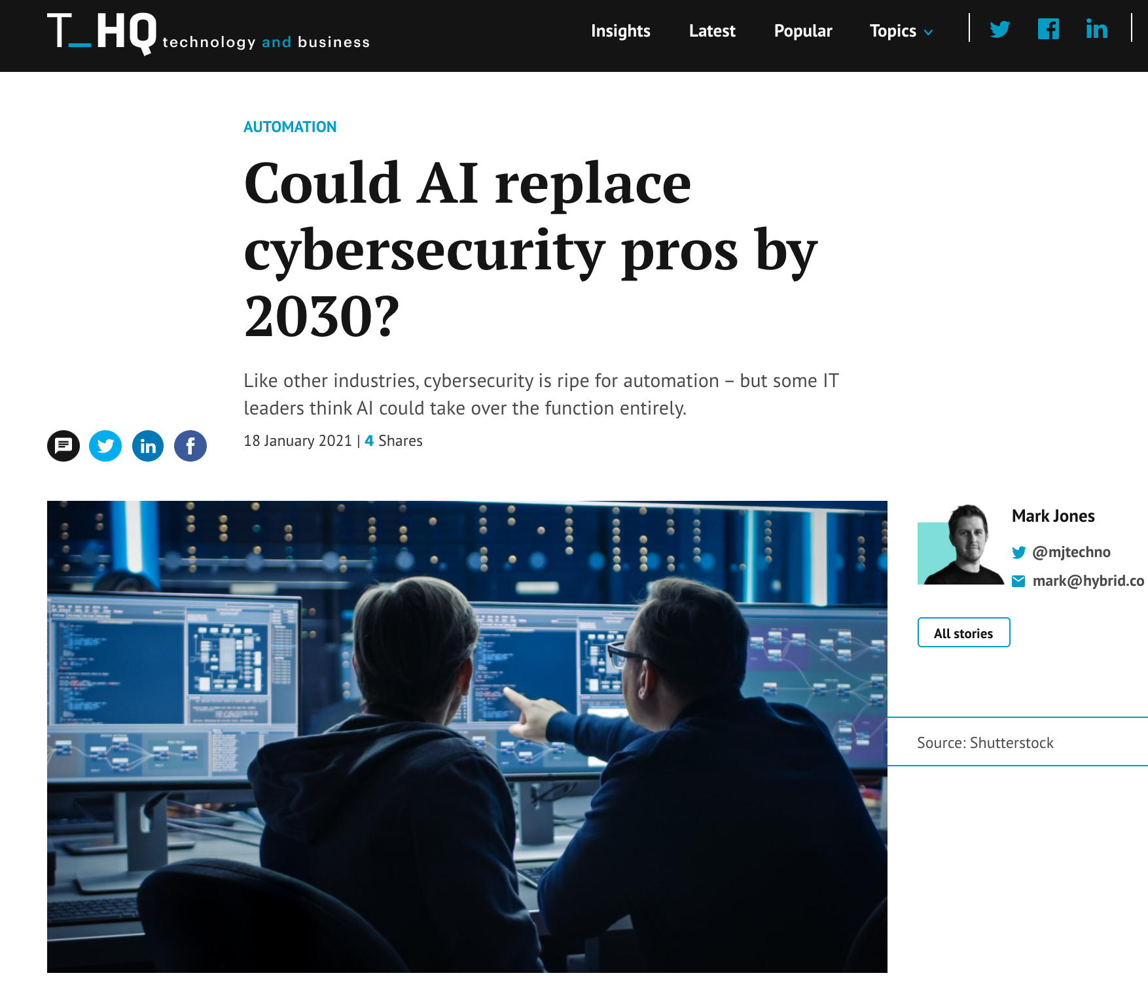
Notes:
As we mention before, there have been a lot of news coverage of the role of AI in cyber security. Some on the technical side, such as how AI makes a more secure cyberstructure by making defense of attacks more efficient; others on the societal impact of AI in the security domain, such as whether AI could replace cybersecurity pros in the future.
Throughout this course, we will discuss relevant topics. In particular, we will demystify machine learning and AI by breaking down into fundamental building blocks, revealing the insights of different models, and demonstrate its usage in the context of cybersecurity.

Slide 10
Module Overview
Notes:
Now, as an overview of this course module, we are at module 1 of this course, where we will walk through the machine learning fundamentals, will applications in security.

Slide 11
Adversaries
Ethics
Attacker’s goals
Attacker’s capabilities
Robustness of model/feature
Privacy
Fairness
Transparency
Modules 2 – 4
Module 4
Module 2
Module 1
Identify Goals & Collect Data
Data Representation
Modeling
Deployment
Pinpoint needs
Data acquisition
Data labeling
Data exploration
Data cleaning
Missing data
Feature selection
Consider fairness
Efficiency
Accuracy
Interpretability
Adversarial resistance
Performance
Evasion and attacks
Model drift
Impact on stakeholders
Module 3
Notes:
This slides shows the structure of this course, which spans the whole data science pipeline in the context of cybersecurity.
In this module, we will focus on the modeling aspect of ML for cybersecurity. Particularly, we will assume that the learning task, including the learning objective and the training data are given, and we will dive into the statistical tools, and discuss the methodology of handling the data and achieving the given objectives.
---
We teach fundamental building blocks, from data ingestion and feature engineering to machine learning model selection.

Slide 12

Foundations of “Modeling”
Machine learning pipeline
The statistical learning framework
Generative & discriminative modeling
Basic supervised learning models
Logistic regression
Naïve Bayes
Neural nets
Unsupervised learning
Dimensionality reduction
Clustering
Credit @NOELIAGOROD
Notes:
Throughout module 1, we will cover a broad spectrum of ML principles and concepts, models and typical usecases.
In particular, we will start of by introducing the ….
-----
CNN
Application in Cybersecurity (as running, concrete examples)
Coloring, animation, highlighting (hand drawing)

Slide 13
Learning Objective

Slide 14
After participating in this module, you will
Understand the basic concepts underlying the practice of ML
Identify practical scenarios…
where ML can play a key role in cybersecurity
Analyze ML models using statistical tools …
and choose the best model for a use case!
Implement for security applications a variety of ML models
E.g., from classical approaches such as logistic regression to representation learning methods such as convolutional neural networks
Notes:
Measurable outcomes
Actionable
----
Some recommendations around reframing the learning objectives as measurable outcomes:
a. Describe the basic ideas and concepts underlying the practice of machine learning
b. Identify where and how machine learning can play a key role in cybersecurity
c. Analyze machine-learning models using statistical tools and choose the best model for a use case
d. Implement for cybersecurity applications a variety of machine learning models, from classical models such as logistic regression to deep learning techniques such as convolutional neural networks

Slide 15
Rest of this module
Pre-recorded video lectures
The statistical learning framework
Supervised learning
Neural networks and deep learning
Unsupervised learning
A primer to ML in python
Exercises and extended reading materials
In-class discussions
Notes:
Might consider reiterating here how the videos, notebooks, and live sessions fit together in the module
1. Order? Watching all the videos, then doing the notebooks? Or doing them in the order provided?
2. How to use notebooks? Just read through them? Encourage them to experiment, etc.?
Exercises and extended reading materials
ML models under the hood (demos in Jupyter notebooks)
Extended reading materials on ML models covered in the video
In-class discussions
Breakout room session 1: Comparison of ML models introduced in this module
Breakout room session 2: Case study and model selection

